Slide 1
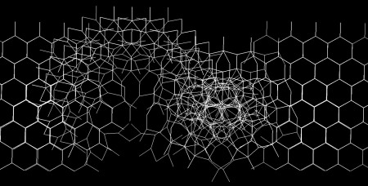
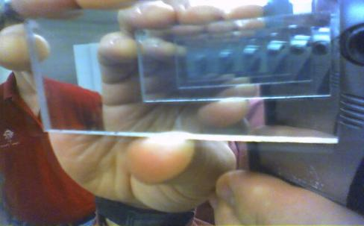



Recursion
The Power of the Recursive Algorithms
Svetlin Nakov
Technical Trainer
www.nakov.com
Telerik Software Academy
academy.telerik.com

Slide 2

Table of Contents
What is Recursion?
Calculating Factorial Recursively
Generating All 0/1 Vectors Recursively
Finding All Paths in a Labyrinth Recursively
Recursion or Iteration?
Harmful Recursion
Optimizing Bad Recursion

Slide 3

What is Recursion?
Recursion is when a methods calls itself
Very powerful technique for implementing combinatorial and other algorithms
Recursion should have
Direct or indirect recursive call
The method calls itself directly
Оr through other methods (see this example: http://www.nakov.com/blog/2013/01/23/)
Exit criteria (bottom)
Prevents infinite recursion

Slide 4
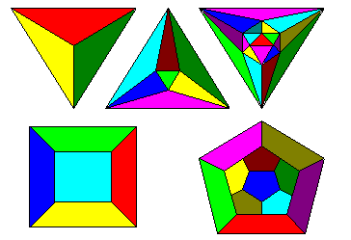
Recursive Factorial – Example
Recursive definition of n! (n factorial):
n! = n * (n–1)! for n >= 0
0! = 1
5! = 5 * 4! = 5 * 4 * 3 * 2 * 1 * 1 = 120
4! = 4 * 3! = 4 * 3 * 2 * 1 * 1 = 24
3! = 3 * 2! = 3 * 2 * 1 * 1 = 6
2! = 2 * 1! = 2 * 1 * 1 = 2
1! = 1 * 0! = 1 * 1 = 1
0! = 1

Slide 5
Recursive Factorial – Example
Calculating factorial:
0! = 1
n! = n* (n-1)!, n>0
Don't try this at home!
Use iteration instead
static decimal Factorial(decimal num) { if (num == 0)
return 1; else
return num * Factorial(num - 1); }
The bottom of the recursion
Recursive call: the method calls itself

Slide 6


Recursive Factorial
Live Demo

Slide 7

Generating 0/1 Vectors
How to generate all 8-bit vectors recursively?
00000000
00000001
...
01111111
10000000
...
11111110
11111111
How to generate all n-bit vectors?

Slide 8
Generating 0/1 Vectors (2)
Algorithm Gen01(n): put 0 and 1 at the last position n and call Gen01(n-1) for the rest:
Gen01(6):
Gen01(5):
x | x | x | x | x | x | 0
x | x | x | x | x | 0 | y
Gen01(5)
Gen01(4)
x | x | x | x | x | x | 1
x | x | x | x | x | 1 | y
Gen01(5)
Gen01(4)
...
Gen01(-1) → Stop!

Slide 9

Generating 0/1 Vectors (3)
static void Gen01(int index, int[] vector)
{
if (index == -1)
Print(vector);
else
for (int i=0; i<=1; i++)
{
vector[index] = i;
Gen01(index-1, vector);
}
}
static void Main()
{
int size = 8;
int[] vector = new int[size];
Gen01(size-1, vector);
}

Slide 10

Generating 0/1 Vectors
Live Demo

Slide 11

Generating Combinations
Simple Recursive Algorithm

Slide 12
Generating Combinations
Combinations are give the ways to select a subset of larger set of elements
Select k members from a set of n elements
Example: there are 10 ways to select 3 different elements from the set {4, 5, 6, 7, 8}:
(4, 5, 6) (4, 5, 7) (4, 5, 8) (4, 6, 7) (4, 6, 8)
(4, 7, 8) (5, 6, 7) (5, 6, 8) (5, 7, 8) (6, 7, 8)
Combinations with and without repetitions can be easily generated with recursion

Slide 13
Generating Combinations (2)
Algorithm GenCombs(k): put the numbers [1..n] at position k the and call GenCombs(k+1) recursively for the rest of the elements:
GenCombs(0):
GenCombs(1):
1 | x | x | x | x | x | x
1 | 1 | x | x | x | x | x
GenCombs(1)
GenCombs(2)
Put all numbers in range [1..n] at position k
Put all numbers in range [1..n] at position k
...
GenCombs(n) → Stop!

Slide 14

Generating Combinations
Live Demo

Slide 15
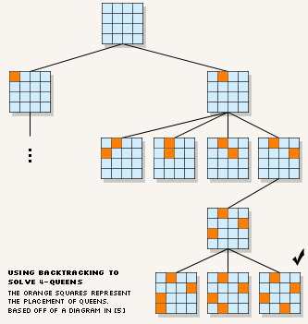
Backtracking
Solving Computational Problems by Generating All Candidates

Slide 16
Backtracking
What is backtracking?
Backtracking is a class of algorithms for finding all solutions to some computational problem
E.g. find all paths from Sofia to Varna
How does backtracking work?
Usually implemented recursively
At each step we try all perspective possibilities to generate a solution
Backtracking has exponential running time!

Slide 17
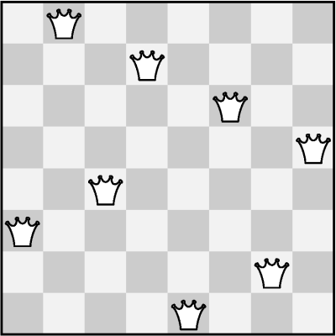
The 8 Queens Problem
Write a program to find all possible placements of 8 queens on a chessboard
So that no two queens attack each other
http://en.wikipedia.org/wiki/Eight_queens_puzzle

Slide 18
Solving The 8 Queens Problem
Backtracking algorithm for finding all solutions to the "8 Queens Puzzle"
static void PutQueens(int count)
{
if (count > 8)
PrintSolution();
else
for (row = 0; row < 8; row++)
for (col = 0; col < 8; col++)
if (CanPlaceQueen(row, col))
{
MarkAllAttackedPositions(row, cow);
PutQueens(count + 1);
UnmarkAllAttackedPositions(row, cow);
}
}

Slide 19
Finding All Paths in a Labyrinth
We are given a labyrinth
Represented as matrix of cells of size M x N
Empty cells are passable, the others (*) are not
We start from the top left corner and can move in the all 4 directions: left, right, up, down
We need to find all paths to the bottom right corner
 |  |  | *
* | * |  | * |  | *
 | * | * | * | * | *
Start position
End position

Slide 20
Finding All Paths in a Labyrinth (2)
There are 3 different paths from the top left corner to the bottom right corner:
0 | 1 | 2 | *
* | * | 3 | * |  | *
6 | 5 | 4
7 | * | * | * | * | *
8 | 9 | 10 | 11 | 12 | 13 | 14
0 | 1 | 2 | * | 8 | 9 | 10
* | * | 3 | * | 7 | * | 11
 |  | 4 | 5 | 6 |  | 12
 | * | * | * | * | * | 13
 |  |  |  |  |  | 14
1)
2)
0 | 1 | 2 | *
* | * | 3 | * |  | *
 |  | 4 | 5 | 6 | 7 | 8
 | * | * | * | * | * | 9
 |  |  |  |  |  | 10
3)

Slide 21
Finding All Paths in a Labyrinth (3)
Suppose we have an algorithm FindExit(x,y) that finds and prints all paths to the exit (bottom right corner) starting from position (x,y)
If (x,y) is not passable, no paths are found
If (x,y) is already visited, no paths are found
Otherwise:
Mark position (x,y) as visited (to avoid cycles)
Find recursively all paths to the exit from all neighbor cells: (x-1,y) , (x+1,y) , (x,y+1) , (x,y-1)
Mark position (x,y) as free (can be visited again)

Slide 22
Find All Paths: Algorithm
Representing the labyrinth as matrix of characters (in this example 5 rows and 7 columns):
Spaces (' ') are passable cells
Asterisks ('*') are not passable cells
The symbol 'e' is the exit (can occur multiple times)
static char[,] lab =
{
{' ', ' ', ' ', '*', ' ', ' ', ' '},
{'*', '*', ' ', '*', ' ', '*', ' '},
{' ', ' ', ' ', ' ', ' ', ' ', ' '},
{' ', '*', '*', '*', '*', '*', ' '},
{' ', ' ', ' ', ' ', ' ', ' ', 'е'},
};

Slide 23
Find All Paths: Algorithm (2)
static void FindExit(int row, int col)
{
if ((col < 0) || (row < 0) || (col >= lab.GetLength(1))
|| (row >= lab.GetLength(0)))
{
// We are out of the labyrinth -> can't find a path
return;
}
// Check if we have found the exit
if (lab[row, col] == 'е')
{
Console.WriteLine("Found the exit!");
}
if (lab[row, col] != ' ')
{
// The current cell is not free -> can't find a path
return;
}
(example continues)

Slide 24
Find All Paths: Algorithm (3)
// Temporary mark the current cell as visited
lab[row, col] = 's';
// Invoke recursion to explore all possible directions
FindExit(row, col-1); // left
FindExit(row-1, col); // up
FindExit(row, col+1); // right
FindExit(row+1, col); // down
// Mark back the current cell as free
lab[row, col] = ' ';
}
static void Main()
{
FindExit(0, 0);
}

Slide 25

Find All Paths in a Labyrinth
Live Demo

Slide 26
Find All Paths and Print Them
How to print all paths found by our recursive algorithm?
Each move's direction can be stored in a list
Need to pass the movement direction at each recursive call (L, R, U, or D)
At the start of each recursive call the current direction is appended to the list
At the end of each recursive call the last direction is removed from the list
static List<char> path = new List<char>();

Slide 27
Find All Paths and Print Them (2)
static void FindPathToExit(int row, int col, char direction)
{
...
// Append the current direction to the path
path.Add(direction);
if (lab[row, col] == 'е')
{
// The exit is found -> print the current path
}
...
// Recursively explore all possible directions
FindPathToExit(row, col - 1, 'L'); // left
FindPathToExit(row - 1, col, 'U'); // up
FindPathToExit(row, col + 1, 'R'); // right
FindPathToExit(row + 1, col, 'D'); // down
...
// Remove the last direction from the path
path.RemoveAt(path.Count-1);
}

Slide 28

Find and Print All Paths in a Labyrinth
Live Demo

Slide 29

Recursion or Iteration?
When to Use and When to Avoid Recursion?

Slide 30
Recursion Can be Harmful!
When used incorrectly the recursion could take too much memory and computing power
Example:
static decimal Fibonacci(int n)
{
if ((n == 1) || (n == 2))
return 1;
else
return Fibonacci(n - 1) + Fibonacci(n - 2);
}
static void Main()
{
Console.WriteLine(Fibonacci(10)); // 89
Console.WriteLine(Fibonacci(50)); // This will hang!
}

Slide 31



Harmful Recursion
Live Demo

Slide 32
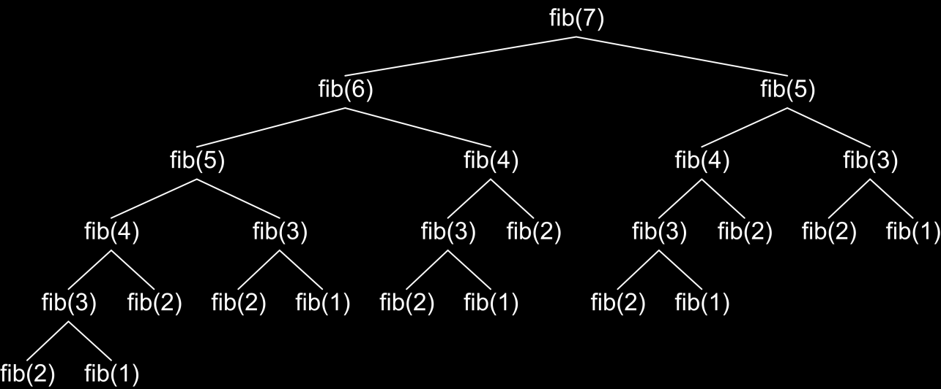
How the Recursive Fibonacci Calculation Works?
fib(n) makes about fib(n) recursive calls
The same value is calculated many, many times!

Slide 33
Fast Recursive Fibonacci
Each Fibonacci sequence member can be remembered once it is calculated
Can be returned directly when needed again
static decimal[] fib = new decimal[MAX_FIB];
static decimal Fibonacci(int n)
{
if (fib[n] == 0)
{
// The value of fib[n] is still not calculated
if ((n == 1) || (n == 2))
fib[n] = 1;
else
fib[n] = Fibonacci(n - 1) + Fibonacci(n - 2);
}
return fib[n];
}

Slide 34

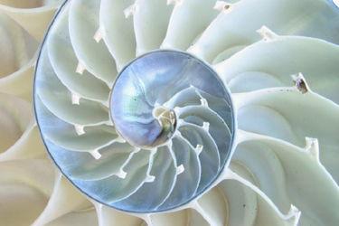
Fast Recursive Fibonacci
Live Demo

Slide 35
When to Use Recursion?
Avoid recursion when an obvious iterative algorithm exists
Examples: factorial, Fibonacci numbers
Use recursion for combinatorial algorithm where at each step you need to recursively explore more than one possible continuation
Examples: permutations, all paths in labyrinth
If you have only one recursive call in the body of a recursive method, it can directly become iterative (like calculating factorial)

Slide 36
Summary
Recursion means to call a method from itself
It should always have a bottom at which recursive calls stop
Very powerful technique for implementing combinatorial algorithms
Examples: generating combinatorial configurations like permutations, combinations, variations, etc.
Recursion can be harmful when not used correctly

Slide 37

Recursion
http://academy.telerik.com

Slide 38
Exercises
Write a recursive program that simulates the execution of n nested loops from 1 to n. Examples:
1 1 1
1 1 2
1 1 3
1 1 1 2 1
n=2 -> 1 2 n=3 -> ...
2 1 3 2 3
2 2 3 3 1
3 3 2
3 3 3

Slide 39
Exercises (2)
Write a recursive program for generating and printing all the combinations with duplicates of k elements from n-element set. Example:
n=3, k=2 → (1 1), (1 2), (1 3), (2 2), (2 3), (3 3)
Modify the previous program to skip duplicates:
n=4, k=2 → (1 2), (1 3), (1 4), (2 3), (2 4), (3 4)
Write a recursive program for generating and printing all permutations of the numbers 1, 2, ..., n for given integer number n. Example:
n=3 → {1, 2, 3}, {1, 3, 2}, {2, 1, 3}, {2, 3, 1}, {3, 1, 2},{3, 2, 1}

Slide 40
Exercises (3)
Write a recursive program for generating and printing all ordered k-element subsets from n-element set (variations V^{k}_{n}).
Example: n=3, k=2, set = {hi, a, b} =>
(hi hi), (hi a), (hi b), (a hi), (a a), (a b), (b hi), (b a), (b b)
Write a program for generating and printing all subsets of k strings from given set of strings.
Example: s = {test, rock, fun}, k=2
(test rock), (test fun), (rock fun)

Slide 41
Exercises (4)
We are given a matrix of passable and non-passable cells. Write a recursive program for finding all paths between two cells in the matrix.
Modify the above program to check whether a path exists between two cells without finding all possible paths. Test it over an empty 100 x 100 matrix.
Write a recursive program to find the largest connected area of adjacent empty cells in a matrix.
* We are given a matrix of passable and non-passable cells. Write a recursive program for finding all areas of passable cells in the matrix.

Slide 42
Exercises (5)
* Write a program to generate all permutations with repetitions of given multi-set. For example the multi-set {1, 3, 5, 5} has the following 12 unique permutations:
{ 1, 3, 5, 5 } { 1, 5, 3, 5 }
{ 1, 5, 5, 3 } { 3, 1, 5, 5 }
{ 3, 5, 1, 5 } { 3, 5, 5, 1 }
{ 5, 1, 3, 5 } { 5, 1, 5, 3 }
{ 5, 3, 1, 5 } { 5, 3, 5, 1 }
{ 5, 5, 1, 3 } { 5, 5, 3, 1 }
Ensure your program efficiently avoids duplicated permutations. Test it with { 1, 5, 5, 5, 5, 5, 5, 5, 5, 5, 5, 5, 5, 5, 5, 5, 5, 5, 5, 5, 5, 5, 5, 5, 5, 5, 5, 5, 5, 5, 5 }.
Hint: http://hardprogrammer.blogspot.com/2006/11/permutaciones-con-repeticin.html

Slide 43
Exercises (6)
* Write a recursive program to solve the "8 Queens Puzzle" with backtracking. Learn more at: http://en.wikipedia.org/wiki/Eight_queens_puzzle

Slide 44




Free Trainings @ Telerik Academy
C# Programming @ Telerik Academy
csharpfundamentals.telerik.com
Telerik Software Academy
academy.telerik.com
Telerik Academy @ Facebook
facebook.com/TelerikAcademy
Telerik Software Academy Forums
forums.academy.telerik.com

